Slide 1
CLUSTER ANALYSIS
PRESENTED BY
NAME: JANGA SAI SUDHESHNA
ROLL.NO: 22P21A4216
BRANCH:CSE-AI&ML-A
COLLEGE:ACET

Slide 2
ABSTRACT
Cluster Analysis is the most fundamental concept in machine learning which is used to discover the underlying patterns in data by grouping similar objects into clusters which means groups. There are many ways of clustering include K-Means, DB-Scan, Hierarchical Clustering and many more. Among all of these techniques K-means is mostly used because of its simplicity and efficiency. Key Aspects such as distance metrics and clustering validation are also addressed.

Slide 3
INTRODUCTION
Machine Learning algorithms are classified into three types: Supervised Learning ,Unsupervised learning and reinforcement Learning k-means is an unsupervised machine learning technique. When the output or response variable is not provided, this algorithm is used to categorize the data into distinct clusters for a better understanding of it. k-means is also known as data-driven machine learning approach since it clusters data based on hidden patterns, insights, and similarities in the data.

Slide 4
Technologies Used
For Clustering The data from the random values in Data Set I Used various technologies during the project They Include:
R programming Language: For Data Manipulation and Visualizations.
ggplot Package: For advanced data visualization this package is used to create insightful plots and visualizations of clustered data including scatter plots with coloured clusters and overlying centroids.
Factoextra Package :A powerful and comprehensive toolbox designed for extracting and visualizing information form multivariate data analysis,particularily from PCA and clustering techniques like K-Means.

Slide 5
EMPLOYED ALGORITHM:
K-means Algorithm: Partitions the data into k clusters by iteratively assigning points to nearest centroid and updating centroids based on mean values until convergence , aiming to minimize within-cluster variance
Hyperparameter Tuning: To optimize model parameters and improve accuracy

Slide 6
PROBLEM STATEMENT
An unsupervised learning technique to Design and implement a K-means clustering algorithm in R to analyze a dataset containing customer purchase behavior. Utilize the algorithm to segment customers into distinct groups based on their purchasing patterns, aiming to identify potential market segments for targeted marketing strategies. Evaluate the clustering results using appropriate metrics and visualize the clusters to provide actionable insights for marketing decisions.

Slide 7
Steps involved during the project:
Import Dataset: Data set required for building the model is loaded by using Kaggle.com
Installing and load necessary packages :Packages like ggplot2 and factoextra which are essential for my project are installed.
Reading the dataset: Data set is read by using read.csv() method and stores in a variable data.
Data preprocessing: Use the techniques like filling empty (NA) values and other cleaning techniques if data set contains any noisy data.
Data Scaling: Before applying the algorithm data scaling must be done which tells about the type of data.

Slide 8
Identifying dependent and independent variables: Removed index number because it is not necessary in clustering the data items
Plotting the data items: Through ggplot2 library primarily test the clustering approach .
Applying Algorithm: we need to specify the number of clusters before in this technique so defining k is first step in this process
Optimal Number of clusters: Using Elbow method identify the k clusters needed and make the data items clusters according to the methods like wss, gap_stat,silhouette.

Slide 9
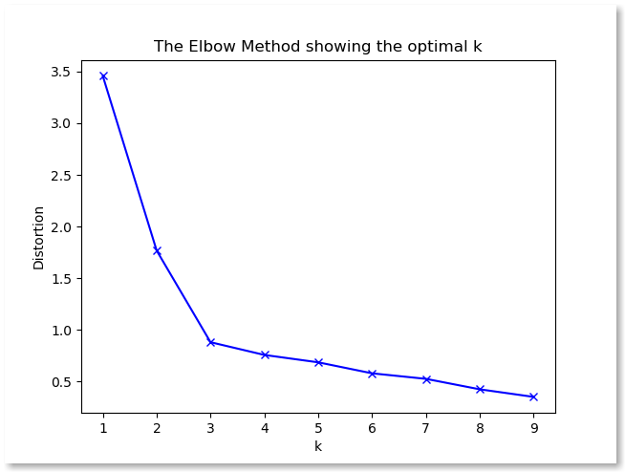
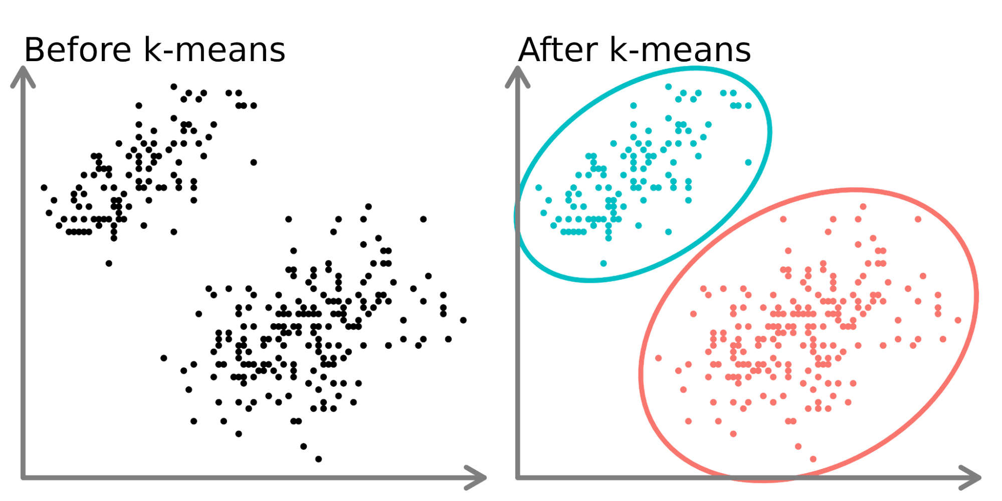
Visualizing the Results:

Slide 10
Results
Visualizing Our Results:The function fviz_cluster() [factoextra package] can be used to easily visualize k-means clusters. It takes k-means results and the original data as arguments. In the resulting plot, observations are represented by points, using principal components if the number of variables is greater than 2
Two Clusters are formed based on the with-in cluster sum of squares based on this method I separated the data items into two clusters.
The data items under 100 are formed into one cluster and above 100 are formed into another cluster.

